Slide 1
AWS Serverless
Rob Koch and Matthew Bonig

Slide 2
Outline
Who We Are
Maximizing production efficiencies in automobiles
Application/systems development follows same path
Workflow example
Code

Slide 3
Rob Koch

Slide 4
Matthew Bonig
Professional Developer 10+ years
Enterprise/SMB application architect
Node/Angular (recovering .NET)
AWS Certified Solutions Architect

Slide 5
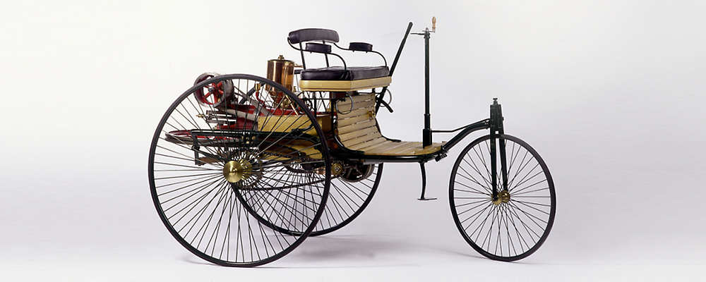
Early Cars – The beginnings
Notes:
In the beginning, there was the Benz Patent Motor Car.
Early days, everything was bespoke. Any parts not created by the manufacturer directly probably weren’t being used elsewhere

Slide 6
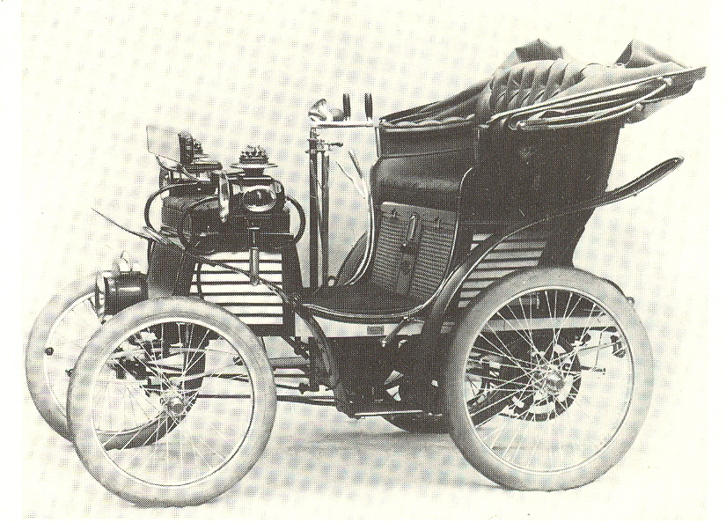
Early Cars – A little more advanced
Notes:
In the beginning, there was the Benz Patent Motor Car.
Early days, everything was bespoke. Any parts not created by the manufacturer directly probably weren’t being used elsewhere

Slide 7
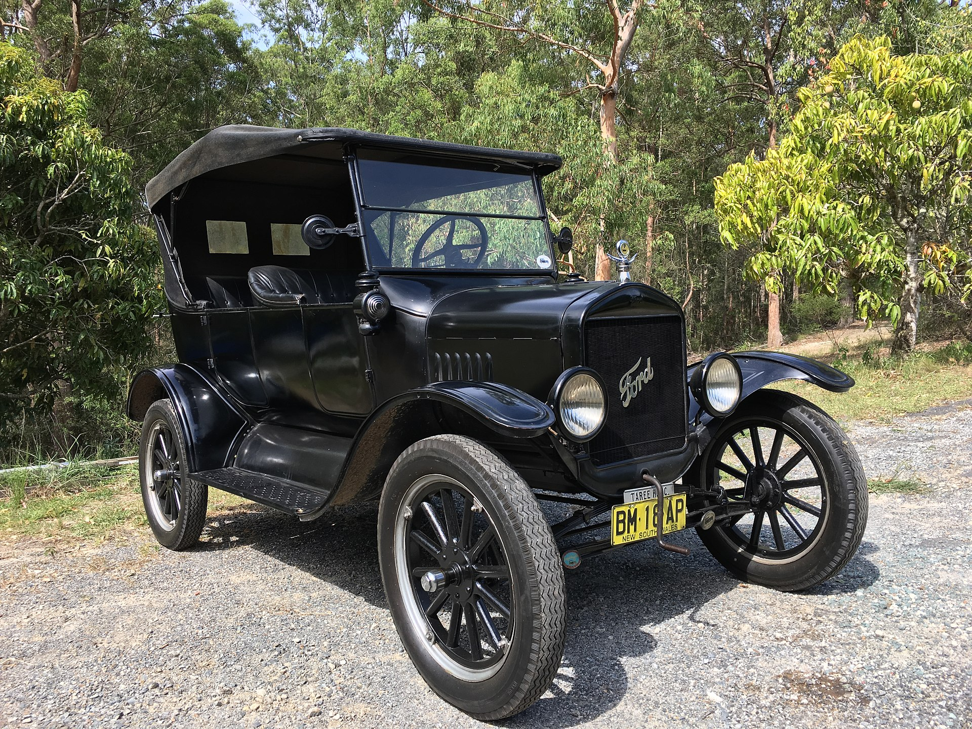
Mass production
Notes:
Ford forever changes auto manufacturing by introduce the production line, allowing for the rapid creation and iteration of the automobile.
Faster iteration resulted in spending less time R&D on common components, once it had been tested and tried through a large enough number of uses, engineers felt comfortable take parts “off the shelf”

Slide 8
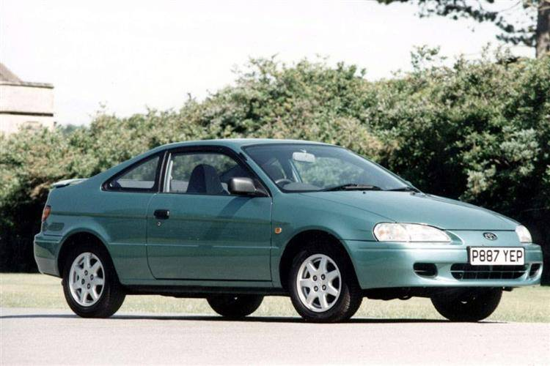
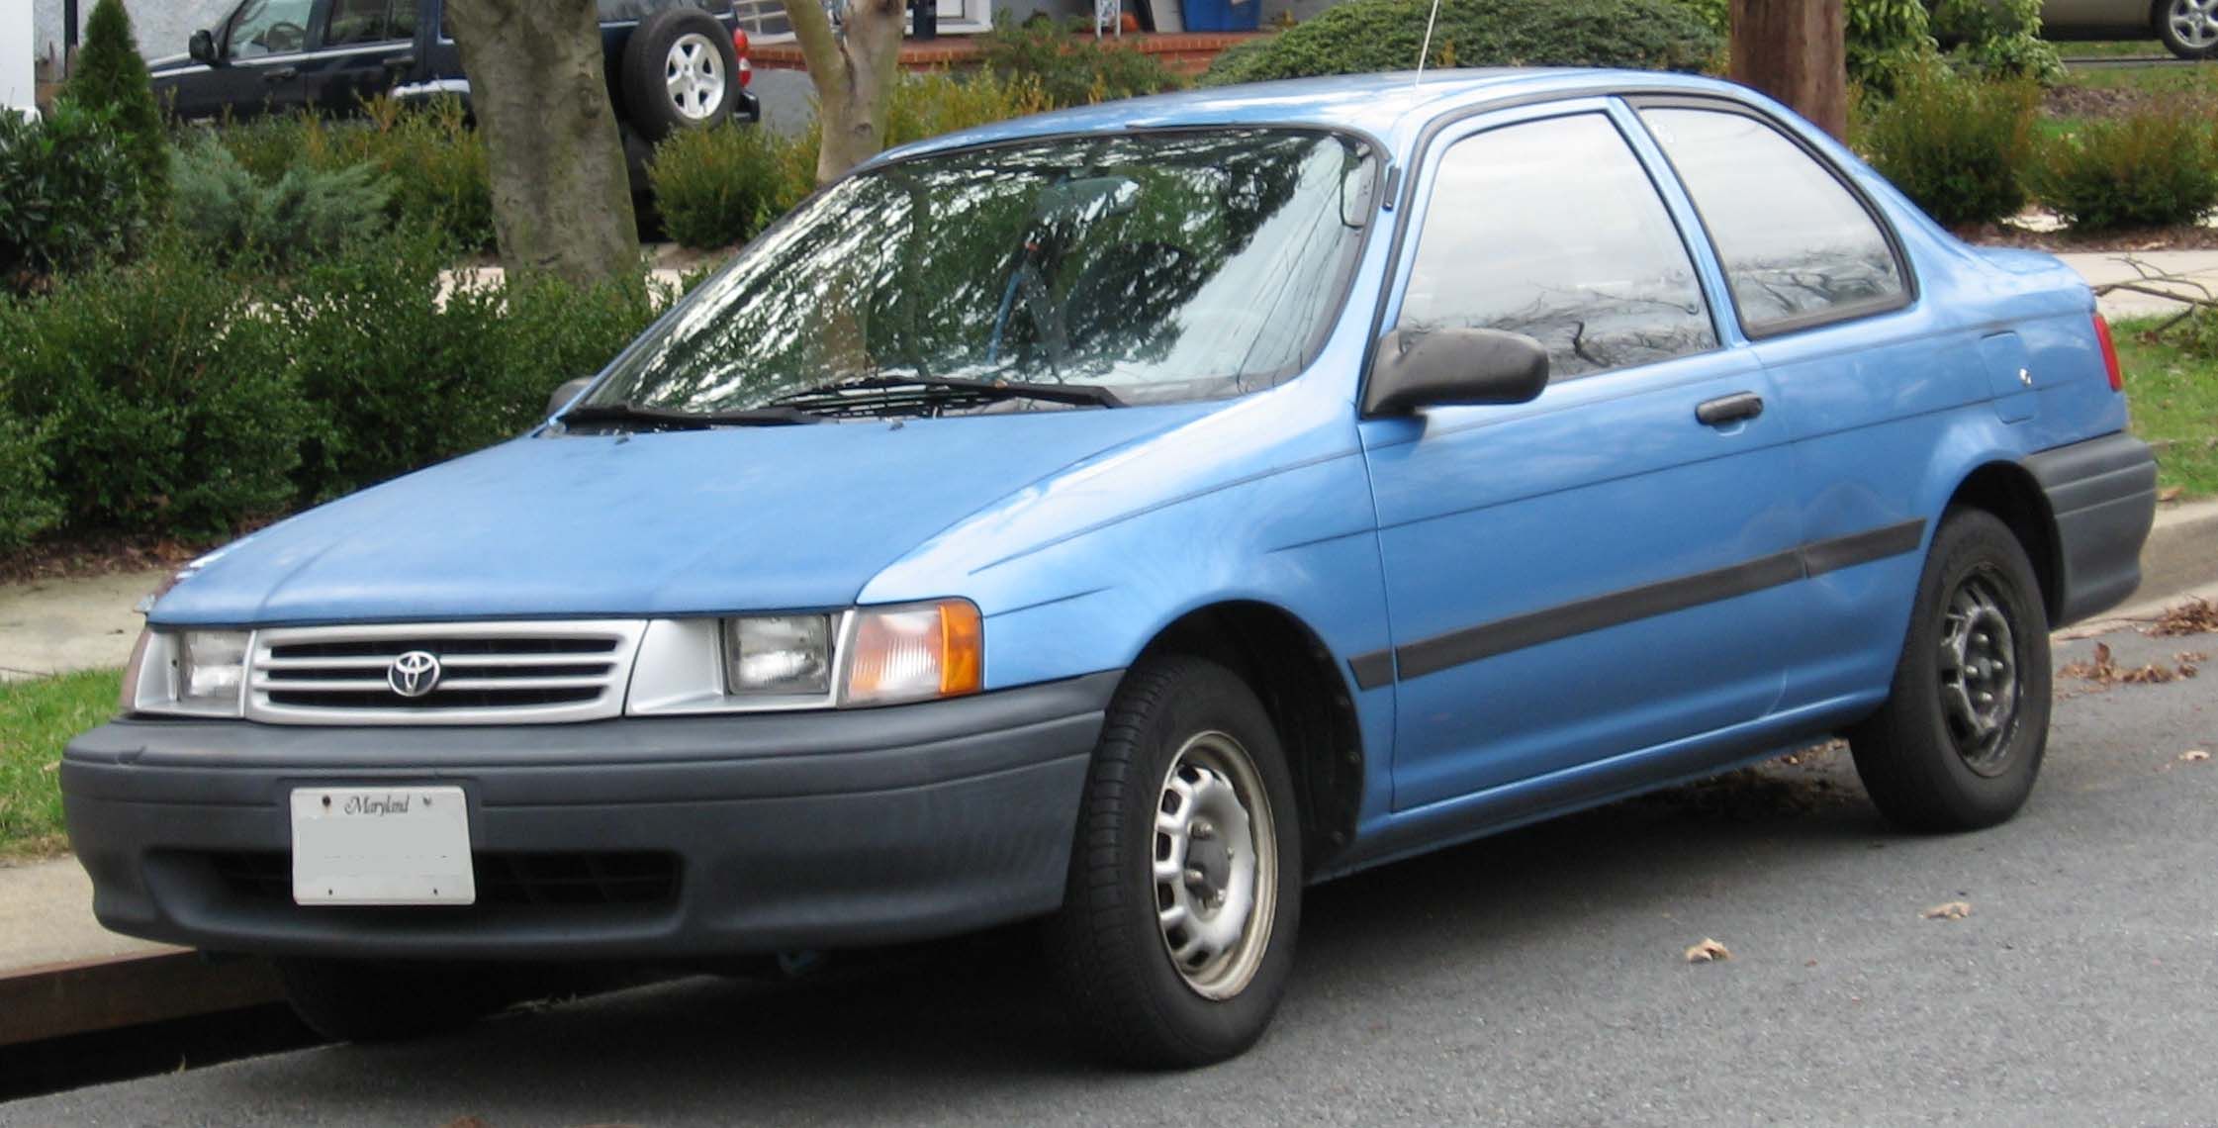
Commoditize
Notes:
It was easy for manufacturers to continue to rely on common designs and components for less superficial parts of the cars. They focused on what they wanted THAT car to be in the market.
Twinning starts to become common, the reuse of nearly the entire car. This would occur across models under the same manufacturer (Toyota Tercel and Pinto-thing). Sometimes even across brands (Toyota and lexus) and corporations (Toyota and Subaru).
Emails, then

Slide 9
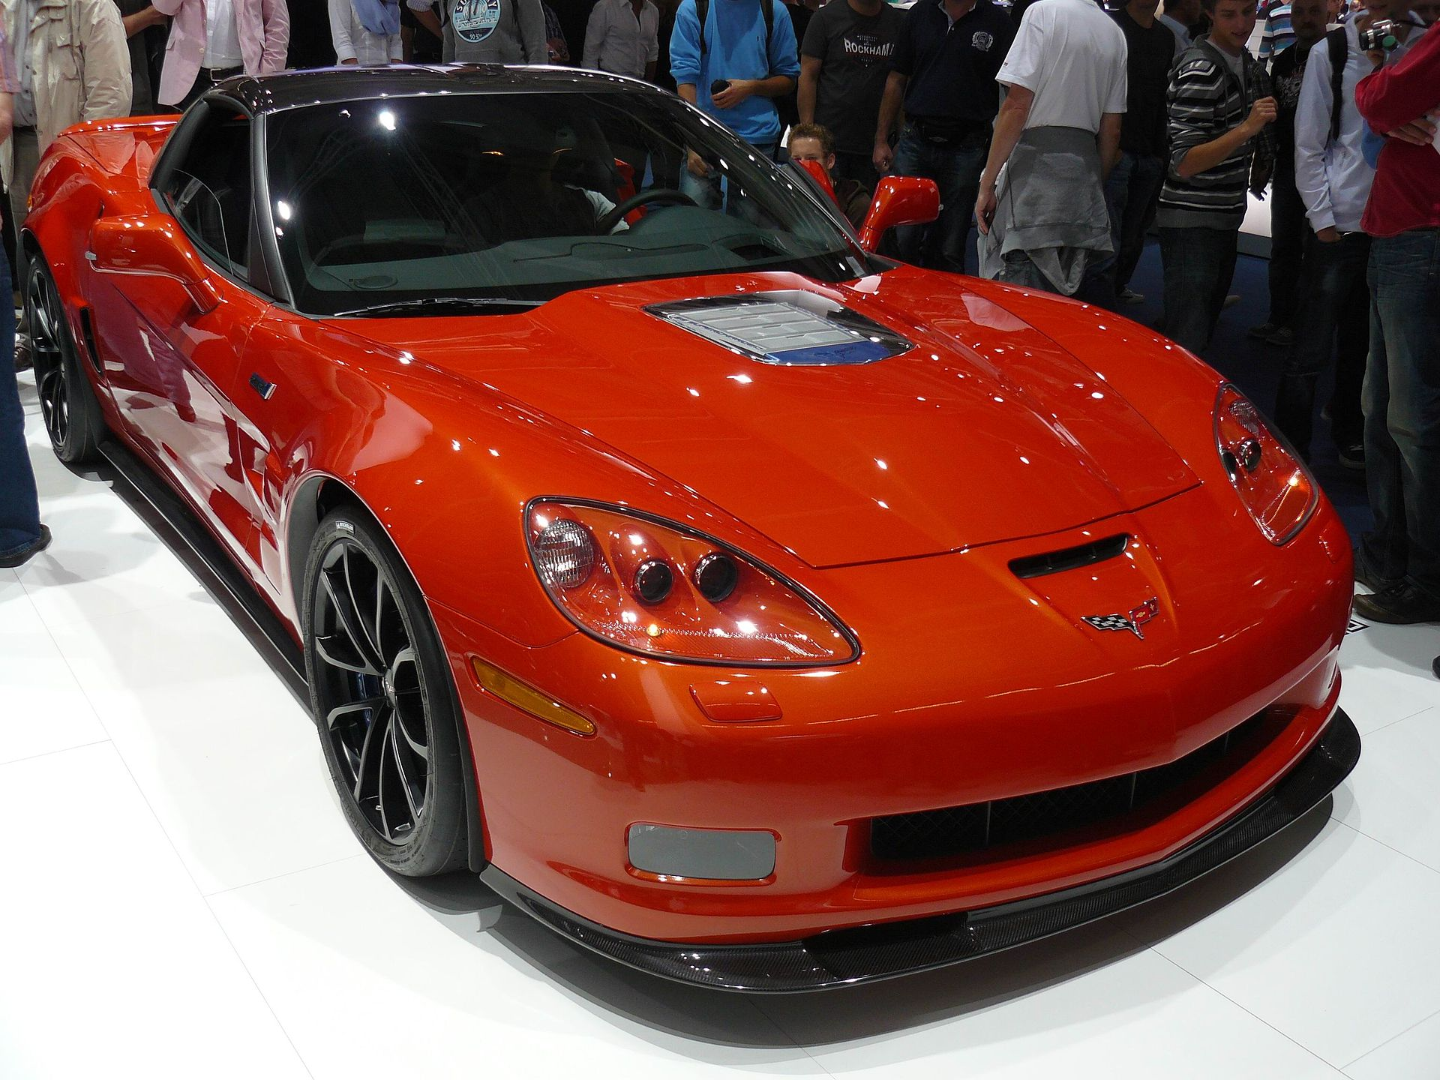
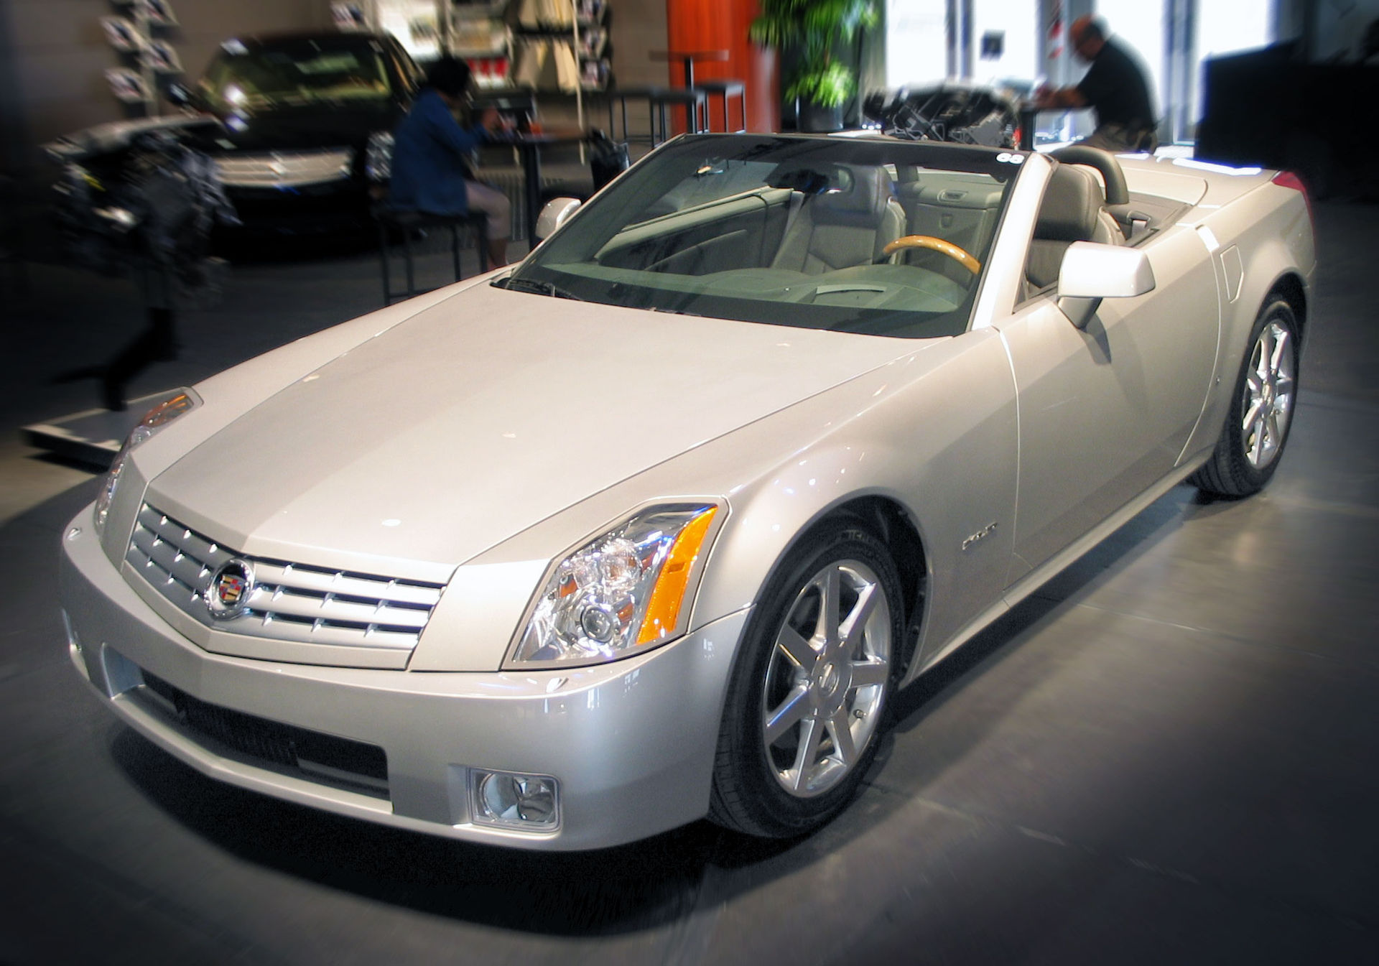
Commoditize
Notes:
It was easy for manufacturers to continue to rely on common designs and components for less superficial parts of the cars. They focused on what they wanted THAT car to be in the market.
Twinning starts to become common, the reuse of nearly the entire car. This would occur across models under the same manufacturer (Toyota Tercel and Pinto-thing). Sometimes even across brands (Toyota and lexus) and corporations (Toyota and Subaru).
Emails, then

Slide 10
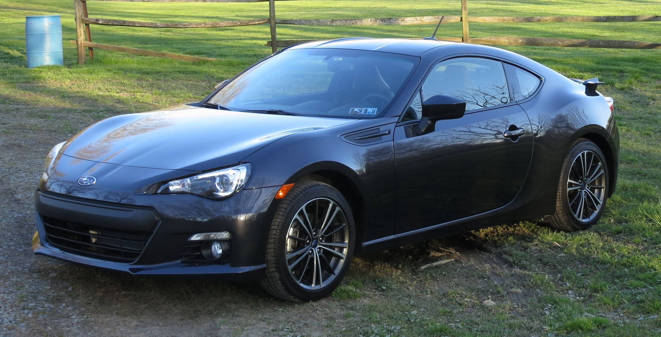
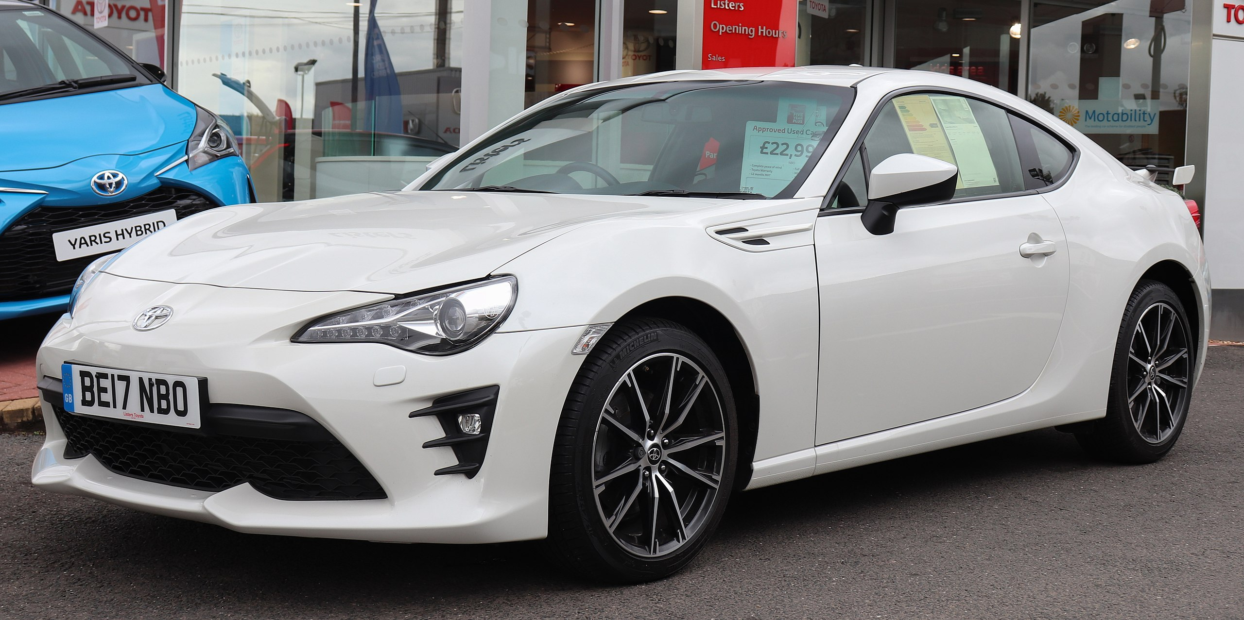
Commoditize
Notes:
It was easy for manufacturers to continue to rely on common designs and components for less superficial parts of the cars. They focused on what they wanted THAT car to be in the market.
Twinning starts to become common, the reuse of nearly the entire car. This would occur across models under the same manufacturer (Toyota Tercel and Pinto-thing). Sometimes even across brands (Toyota and lexus) and corporations (Toyota and Subaru).
Emails, then

Slide 11
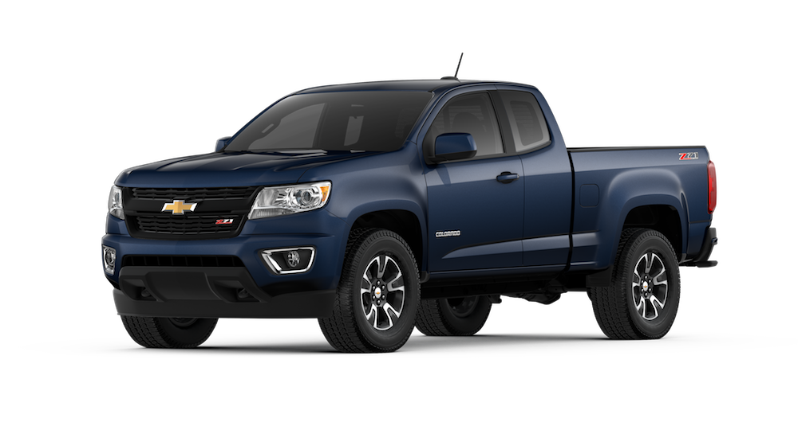
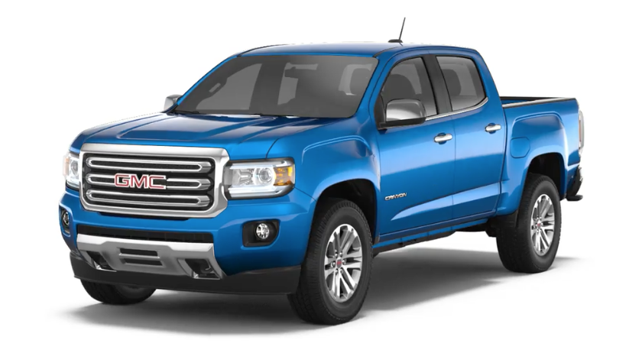
Commoditize
Notes:
It was easy for manufacturers to continue to rely on common designs and components for less superficial parts of the cars. They focused on what they wanted THAT car to be in the market.
Twinning starts to become common, the reuse of nearly the entire car. This would occur across models under the same manufacturer (Toyota Tercel and Pinto-thing). Sometimes even across brands (Toyota and lexus) and corporations (Toyota and Subaru).
Emails, then

Slide 12
Specialization
Chevrolet Colorado Sales Numbers
Sales Results - USA - Colorado
Year | Jan | Feb | Mar | Apr | May | Jun | Jul | Aug | Sep | Oct | Nov | Dec | Total
2019 | 11,165 | 11,165 | 11,165 |  |  |  |  |  |  |  |  |  | 33,494
2018 | 8,011 | 8,050 | 12,798 | 13,672 | 13,672 | 13,672 | 11,654 | 11,654 | 11,654 | 10,001 | 10,001 | 10,001 | 134,842
$38,095
GMC Canyon Sales Numbers
Sales Results - USA - Canyon
Year | Jan | Feb | Mar | Apr | May | Jun | Jul | Aug | Sep | Oct | Nov | Dec | Total
2019 | 2,318 | 2,318 | 2,318 |  |  |  |  |  |  |  |  |  | 6,954
2018 | 2,171 | 2,319 | 2,723 | 3,212 | 3,212 | 3,211 | 2,808 | 2,808 | 2,808 | 2,740 | 2,740 | 2,740 | 33,492
$40,395
+ ~6%
Notes:
By cutting R&D costs to only superficial components (styling and interior) we see a highly specialized industry right now.
GMC Canyon and Chevy Colorado. Nearly identical.

Slide 13
Beginning to Highly Commoditized
1885 to 2015

Slide 14
Software Systems – The Beginning
Each server was physical hardware
Each system was bespoke
Very difficult

Slide 15
Mass Production
Virtual Hardware, VM Ware, Hyper V
Mid 2000s
Allowed for a much quick production of new software systems

Slide 16
Commoditized
Virtual machines with base images (EC2 with AMIs)
Service oriented architectures became dominant
Everything is a service
Notes:
Your standard web application architecture is the Chevy Colorado of software systems. Everyone’s got one, they don’t vary too much. Container or AMI is your web tier, db is a service, sqs (pub sub) is a service, email is a service, everything is a service. Container/web server is your engine, transmission is your database. Email is your wheels, scalability is your frame.

Slide 17
Serverless
Serverless is the evolution of a highly iterated upon software architecture (SOA) that aims to extract common application components into easily consumable managed services.
As the auto manufacturer now spends little on R&D for common components like shocks, brakes, frame designs, etc., Serverless allows system architects to leverage well designed and managed dbs, api endpoint services, worker processes, etc., reducing R&D and increasing TTM while reducing TCO.

